Slide 1
INTEREST RATE PREDICTION
INTEREST RATE PREDICTION
~ TEAM SCKNN ~
Sushil Deore | Nancy Luong | Natalia Mora | Kenneth Mccarthy | Charan Kanwal Preet Singh
Notes:
https://drive.google.com/file/d/1ByFV2s8sckMo2vasQ9oCJmi5IgrjGaVo/view?usp=share_link

Slide 2
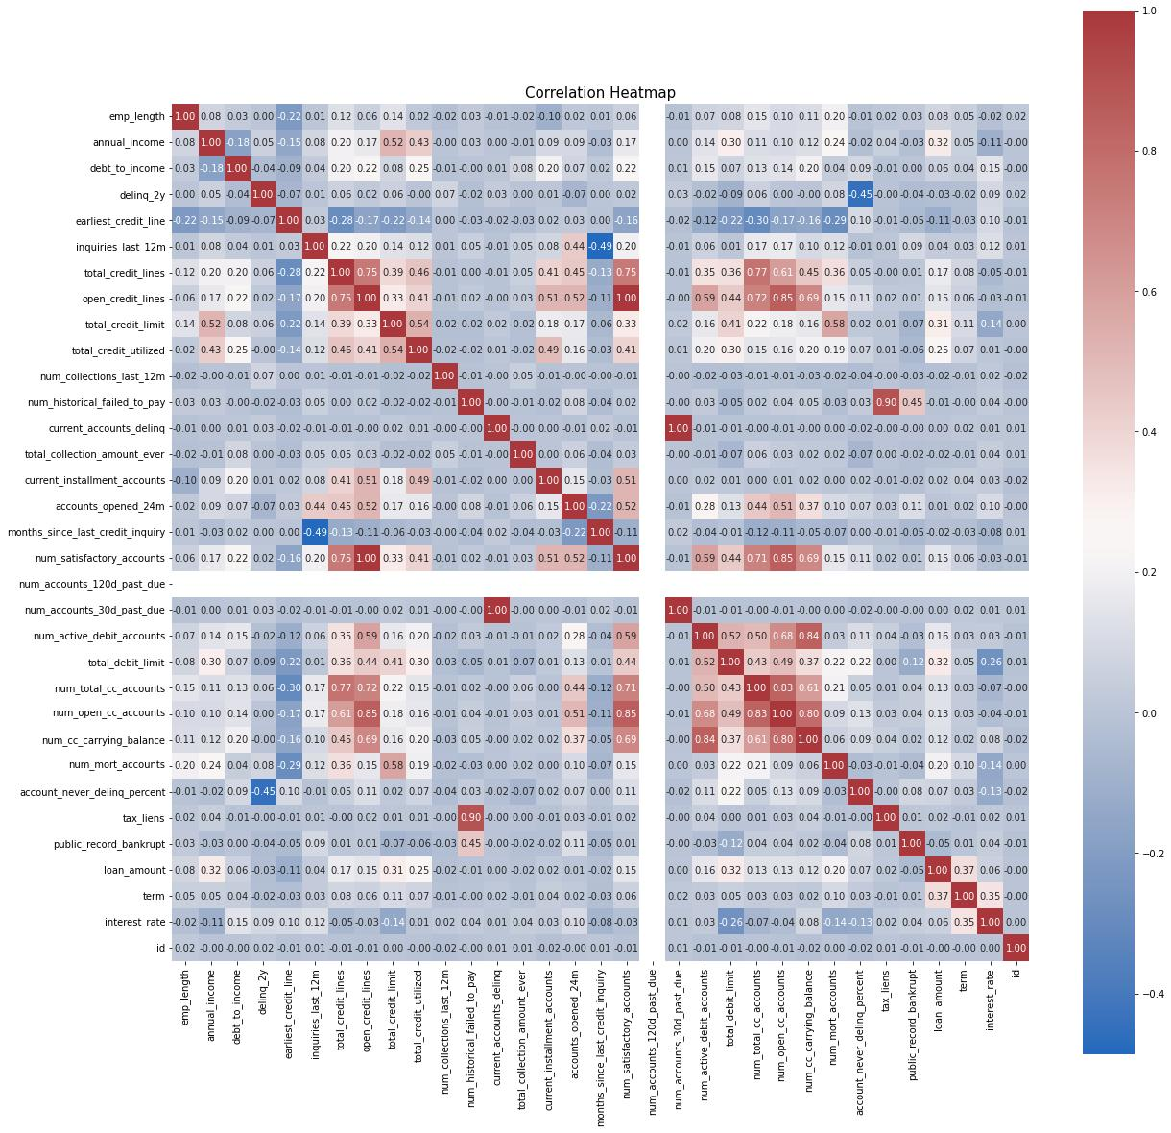
Data Exploration Analysis
Understand data using the process of trial and errors including:
Non-graphical analysis
Univariate Analysis
Multivariate Analysis

Slide 3
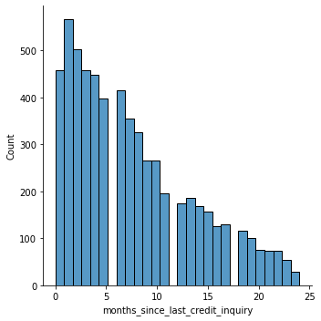
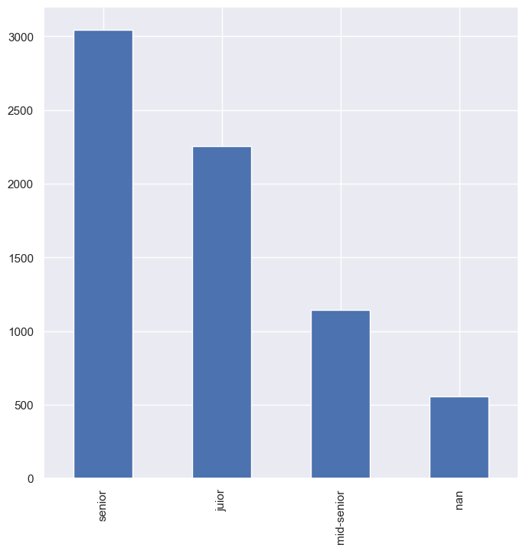
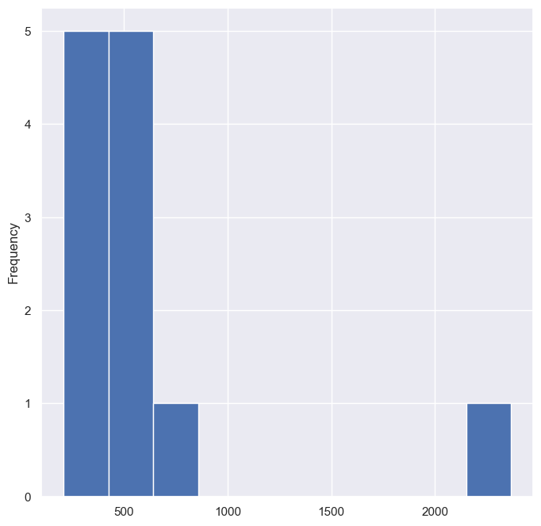
Data Cleaning & Preprocessing
Handling Null Values:
Full drop of attribute if >50% NA
Attribute distributions to determine proper imputation method
Qualitative Attributes:
Outlier treatment
Min/max scaling to normalize data
Impute with median value due to skewed data
Quantitative Attributes:
Recognizing/transforming discrete numeric attributes to categorical
Condensing underrepresented values into “other” categories
Example:
Attribute appear categorical, but deeper exploration reveals numerical data type
Imputing using MEDIAN significantly affects distribution
>> Best Option: binning column with additional sublevel for missing values
BEFORE
AFTER

Slide 4
Data Visualization
Raw Quantitative variables versus Target Variable (Interest Rate)

Slide 5
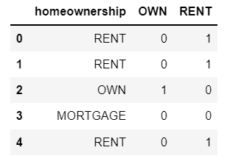
Feature Engineering
Perform feature engineering In order to reduce dimensionality of model and improve accuracy
Perform one hot encoding to be able to include categorical variable in model.
Convert categorical variables into several binary valued columns
Identify columns that have high correlation with each other and eliminate redundancy

Slide 6
Modeling
Model: Several algorithms were created to determine the most accurate predictor. These models included:
Linear Regression
WIth Recursive Feature Elimination
With LassoCV Feature Selection
With ElasticNetCV
Decision Trees
AdaBoost
Gradient Boost
Ultimately Random Forest Regression model yielded the most accurate results
Model Justification: Random Forest produced the best R2 score of all models tested

Slide 7
Hyperparameter Tuning
The hyperparameters of the Random Forest Regression model are max_depth, n_jobs, and min_samples_leaf.
These were optimized using a randomized grid search to iterate over many combinations of hyperparameters in order to select the ones that led to the best model

Slide 8
Accuracy Report
Metric: The R2 score was used as a metric for judging the model
Model had R2 of 0.39 for training data
Model had R2 of 0.34 for test data
Metric Justification:
The R2 metric provides a simple to judge metric between 0 and 1 to easily judge model quality.

Slide 9
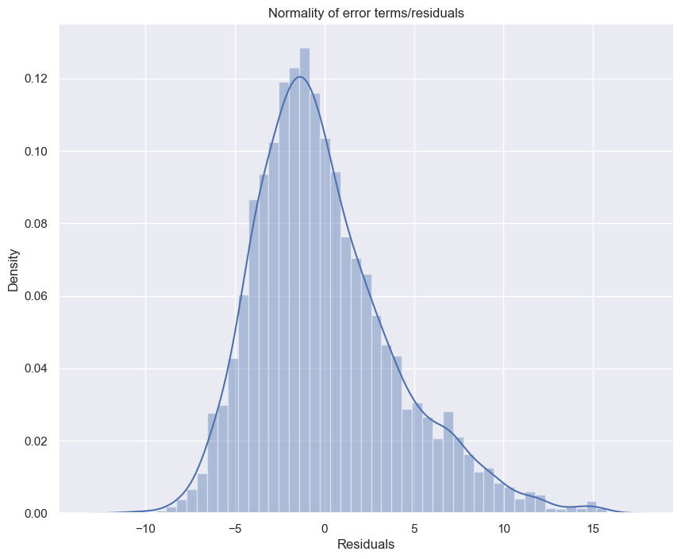
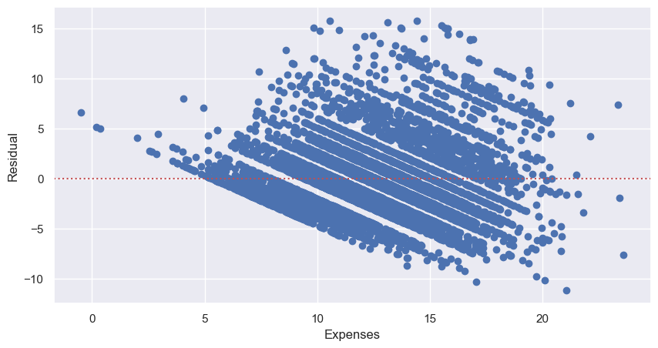
Accuracy Report
Distribution of error terms on training dataset:
Residuals Versus Predictions:
Residual Analyses

Slide 10
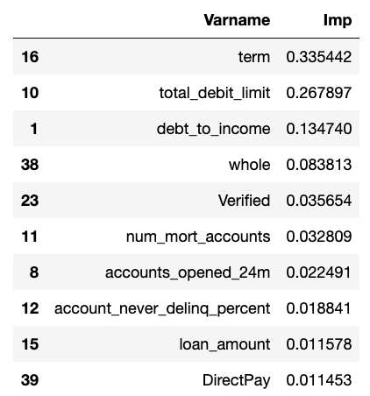
Conclusion
Random Forest Regression model gives the best prediction for this dataset
The table to the right displays the top 10 attributes that hold the most weight in predicting interest rate.
Term
Total Debt Limit: this correlation makes intuitive sense as limits are determined based on an individual’s financial history and therefore is likely to reflect their likelihood to show financial responsibility

Slide 11
Conclusion
01
02
03
PROBLEM & SOLUTION
OUR PROCESS
TARGET
Here you could describe the topic of the section
Here you could describe the topic of the section
Here you could describe the topic of the section

